Slide 1


Market Opportunities 2024!
Monday, May 13| 12:30 pm
Presented by:
David G. Dietze, JD, CFA, CFP®
Managing Principal, Senior Portfolio Strategist
1

Slide 2

Peapack Private
Adherence to the highest fiduciary standards
Peapack-Gladstone Financial Corporation is a New Jersey bank holding company with total assets of $6.1 billion and assets under management/administration of $11.5 billion as of March 31, 2024.
Customized Investment Management + Holistic Financial Planning for Individuals, Families, and Small Institutions
Managed for Tax Efficiency and Transparency

Slide 3
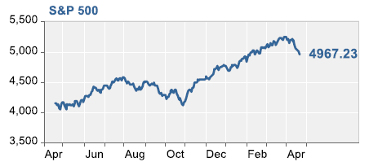
Market Outlook: Near Term Uncertainty but Fundamentally Bullish
Inflation….is it abating?
Interest rates will follow
Federal Reserves focused on when to cut, not hike, rates
US Gov’t engaged in major deficit spending
Economy/unemployment still looking good
In an election year of a first term president

Slide 4
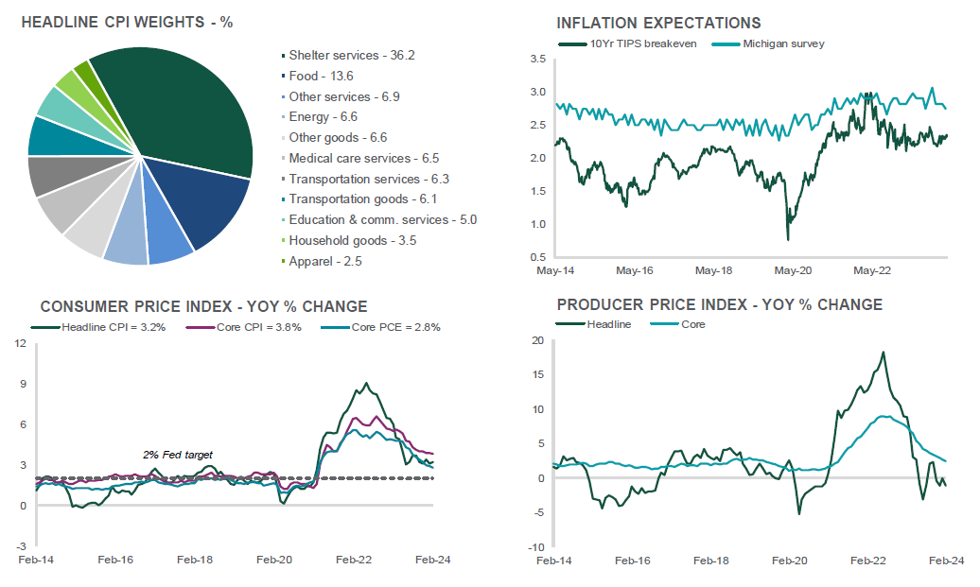
Inflation Recedes, But Is It Getting “Sticky?”

Slide 5
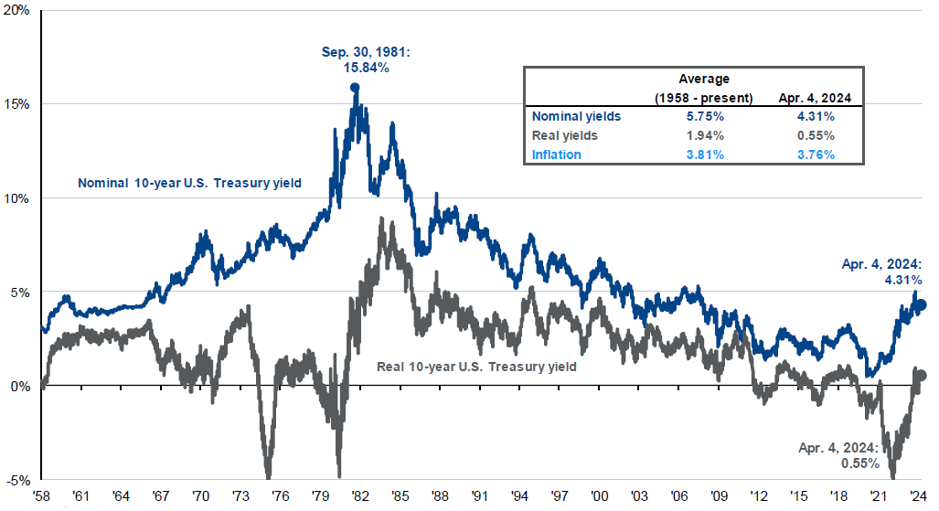
Interest Rates: Historically Low But
Where Do We Got From Here?

Slide 6
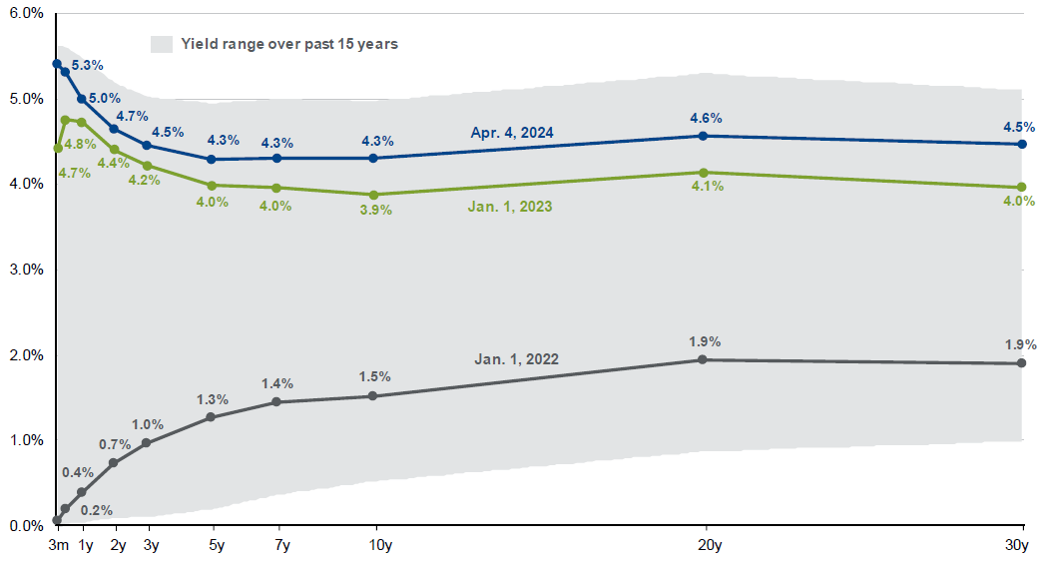
Interest Rates: Can We Uninvert?

Slide 7
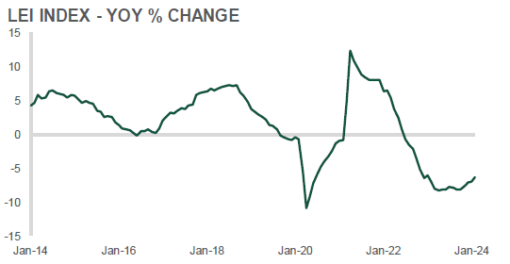
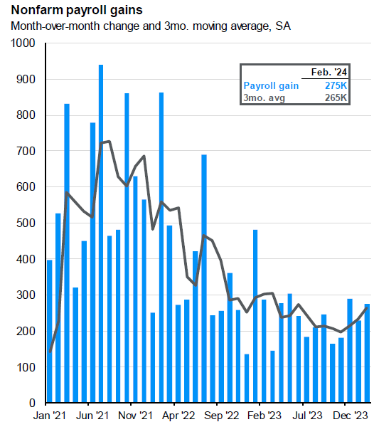
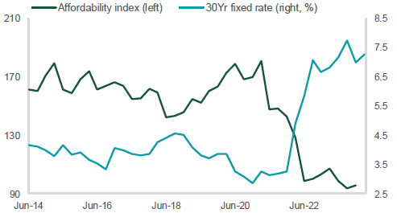
Economy: Consumers Have Jobs!

Slide 8
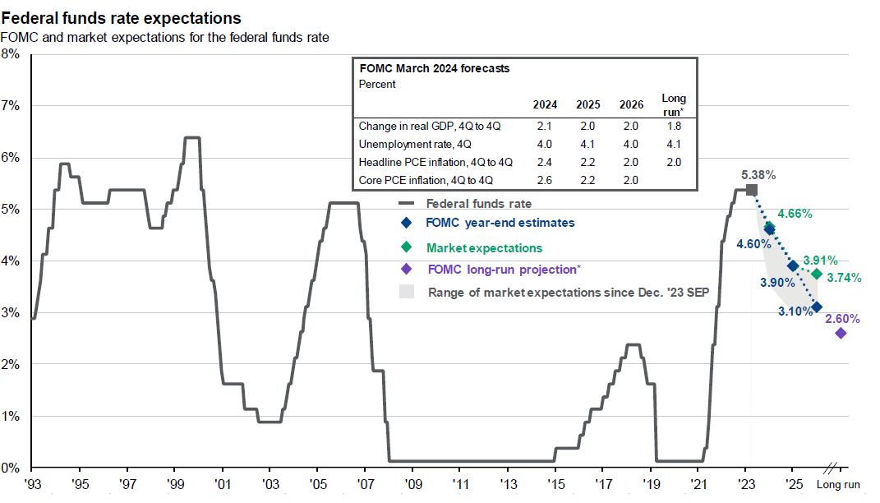
Federal Reserve Focused on Cutting
Interest Rates, But When?

Slide 9
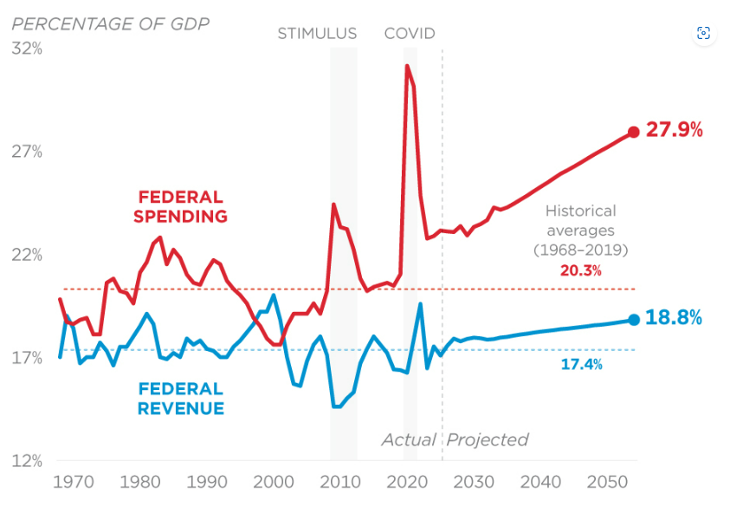
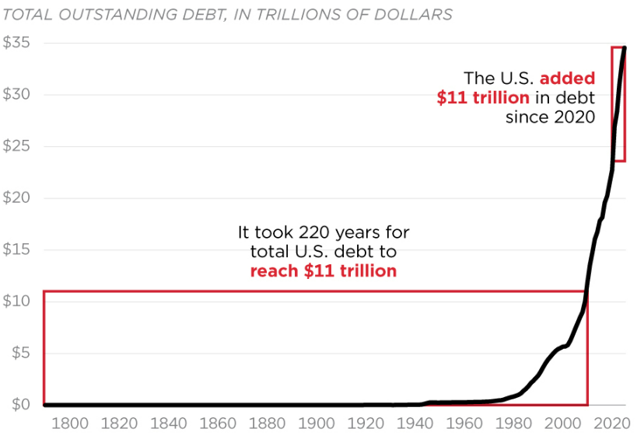
Big Spending by US Government

Slide 10
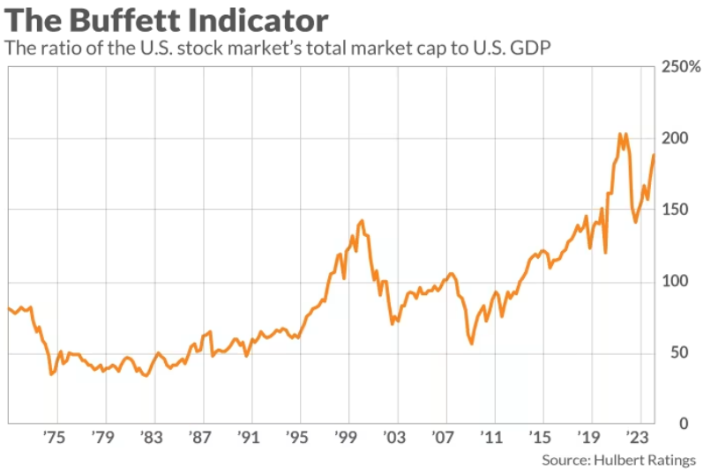
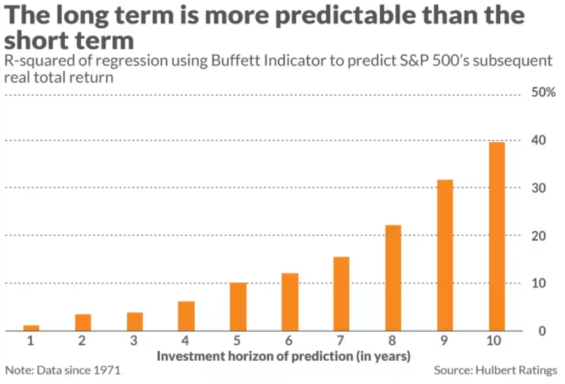
Reason for Caution: Valuations!

Slide 11
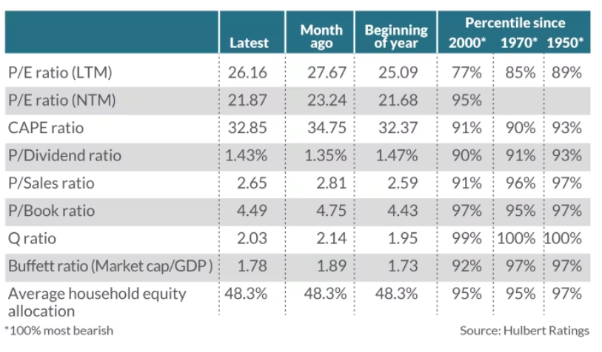
Metrics of Every Type Show Overvaluation!

Slide 12
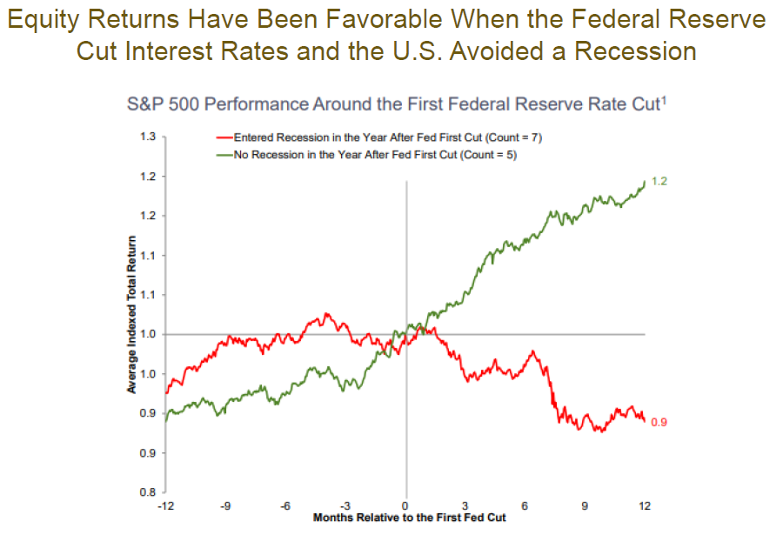
Recession is a Perennial Risk!
Source: Investment Strategy Group, Bloomberg.
Past performance is not indicative of future result, which may vary.
Based on data since 1945.

Slide 13

Many Reasons for Caution
Valuations
Inflation sticky
Interest rates backing up
Federal Reserve may not cut rates
Recession
Excessive speculation
Geopolitical
Faltering tech leadership
Commercial real estate.

Slide 14

Investment Philosophy!
Save (early)
Think long term
Prefer risk assets
Avoid big cash balances
Hard to beat the market
Low turnover
Taxes matter
Individual stocks can trump index funds
There’s more than just the S&P 500 as to index funds
Avoid private investments
Avoid real estate owned directly
Avoid cocktail chatter stocks

Slide 15
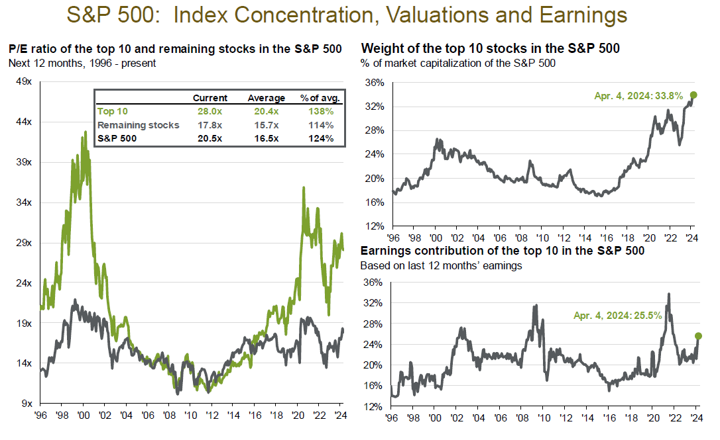
Investment Tip: Limit Exposure to Megacaps!

Slide 16
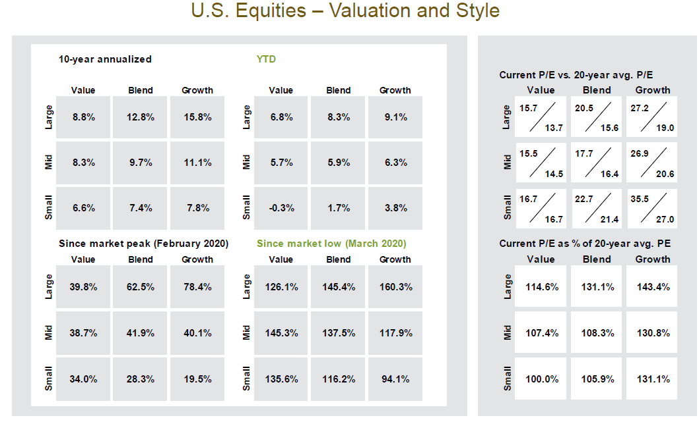
Investment Tip: Small Caps May Offer Opportunity!

Slide 17
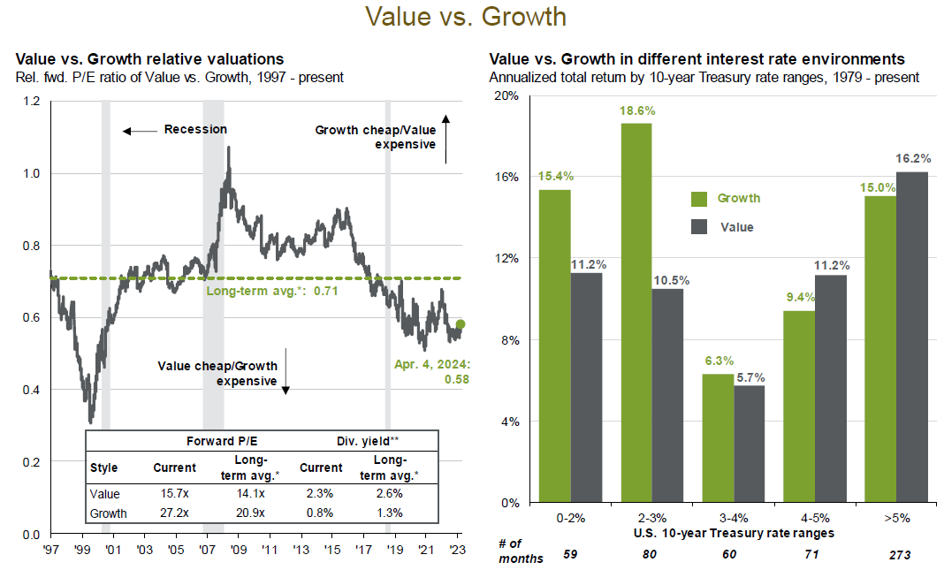
Investment Tip: Search for Value!

Slide 18
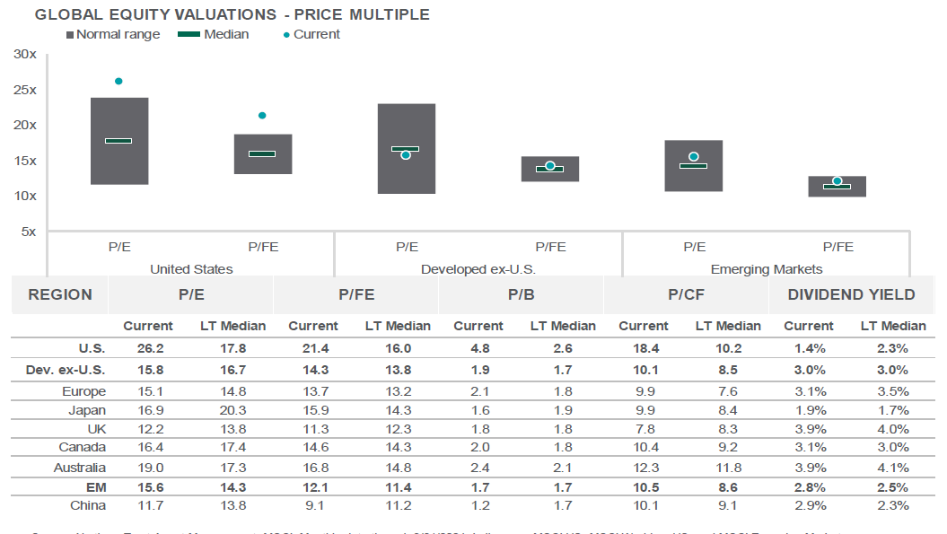
Investment Tip: Look Offshore!

Slide 19
Investment Tip: Int’l vs Domestic Have Cycled Back and Forth!
Source: FactSet, MSCI, J.P. Morgan Asset Management.
Regime change determined when cumulative outperformance peaks and is not reached again in the subsequent 12-month period. *Peak MSCI EAFE outperformance vs. MSCI USA occurred in April 2023. If this is sustained for 12 months, the regime will switch in April 2024. Guide to the Markets – U.S. Data are as of April 4, 2024.

Slide 20
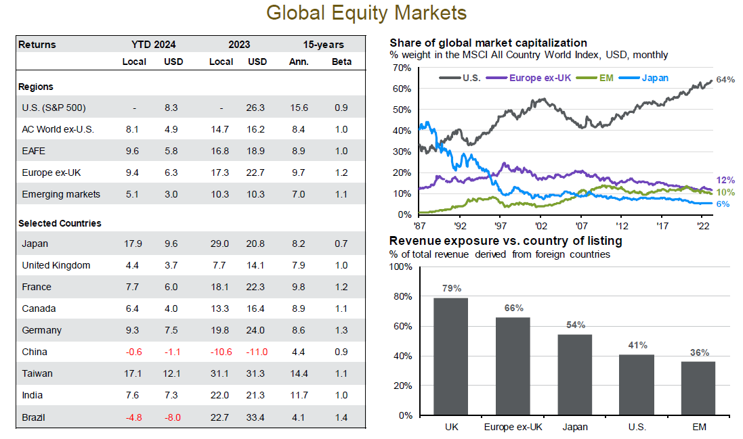
Investment Tip: Reversion to the Mean is a
Powerful Investment Phenomenon!

Slide 21
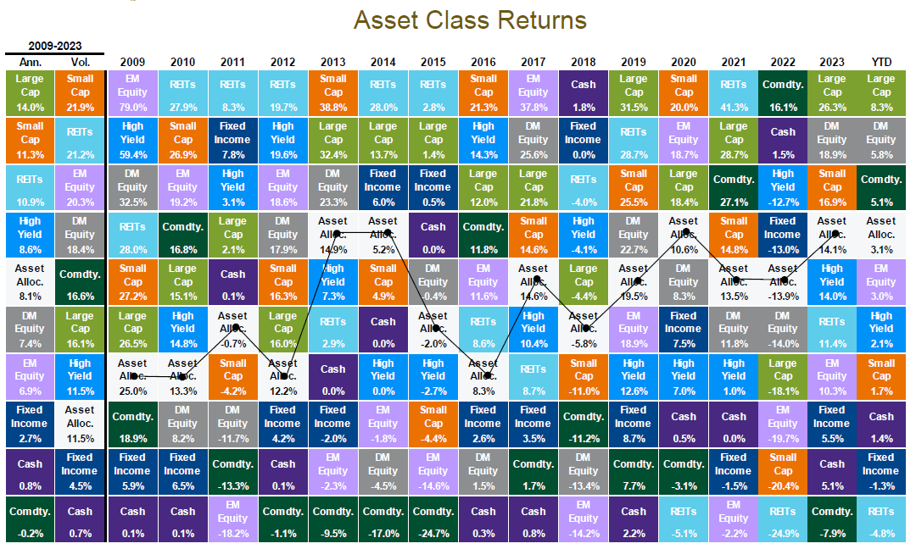
Investment Tip: Stay Diversified!

Slide 22
Thank you for attending!
David G. Dietze, JD, CFA, CFP®
Managing Principal, Senior Portfolio Strategist
25 Deforest Ave., Suite 105, Summit, NJ 07901
ddietze@pgbank.com
973.738.3770

